Slide 1
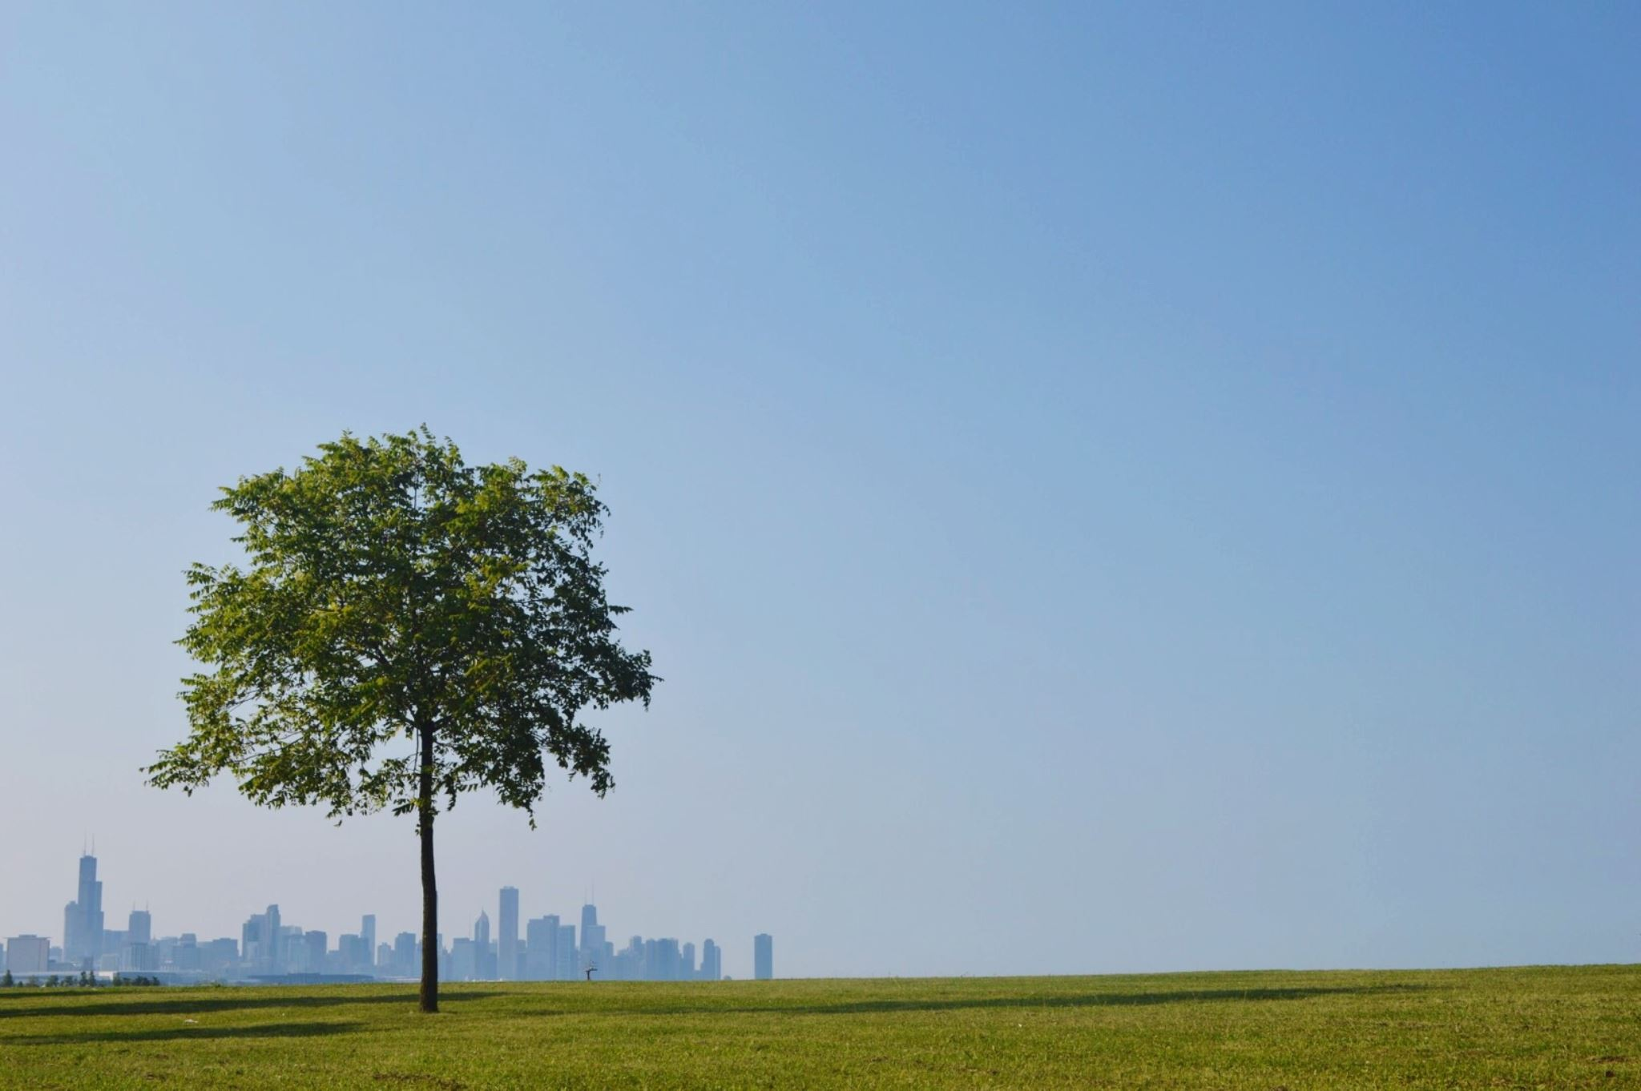
Analysis Of Street Tree Data in New York City
Nini Soselia
CSCI 118 Capstone Project

Slide 2

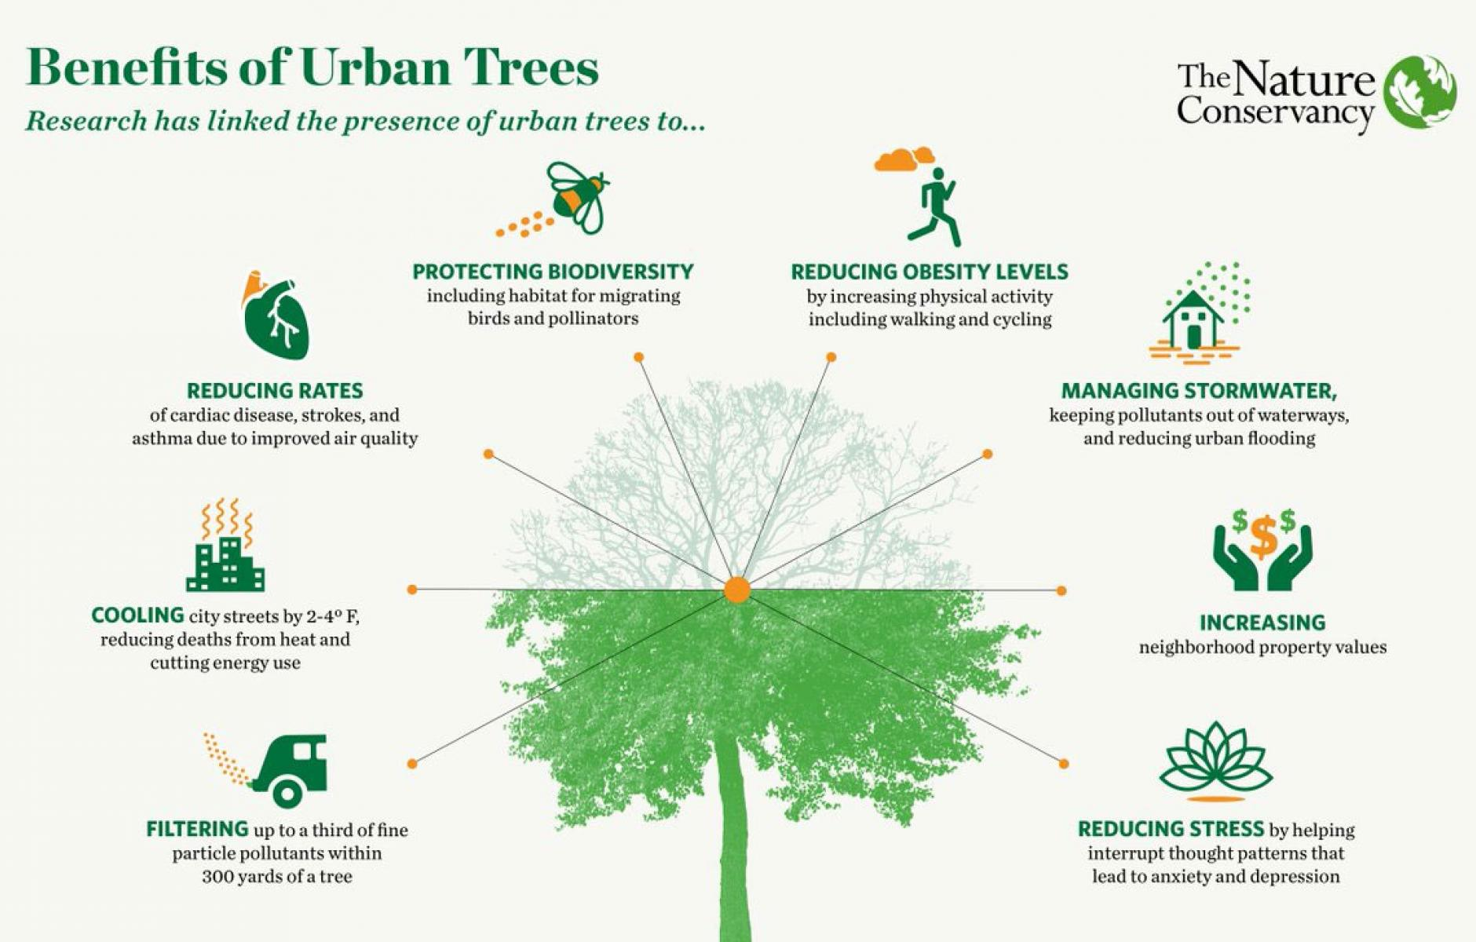
The goal of the project
The project aims to analyze and compare the number of trees and their condition across the boroughs of NYC.
Trees play an essential role in developing a healthy urban environment. Availability and quality of green spaces, such as parks, forests, and other natural areas, can significantly influence the overall quality of life for residents
https://www160.statcan.gc.ca/index-eng.htm
This project interests me as a Human Geographer, as I find it fascinating to understand how environmental features shape human experiences and vice versa.
https://www.cnu.org/publicsquare/2018/12/14/benefits-urban-trees

Slide 3
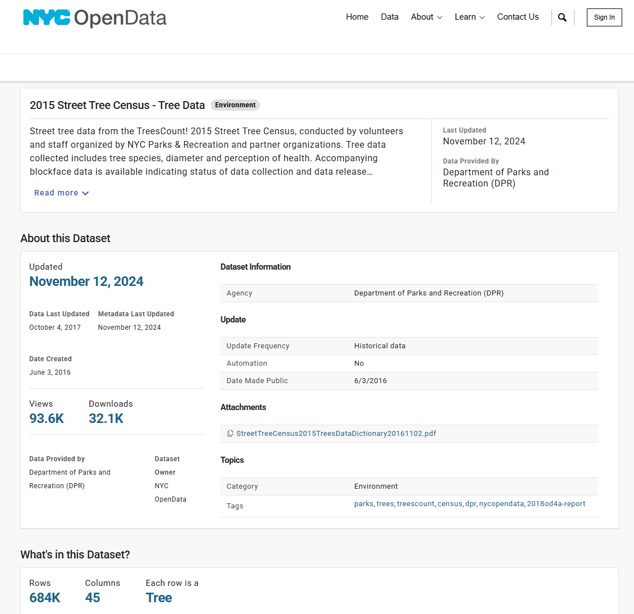
About the Data
https://data.cityofnewyork.us/Environment/2015-Street-Tree-Census-Tree-Data/uvpi-gqnh/about_data
For the analysis, I used the 2015 NYC Street Tree Census data. The Data is provided by the Department of Parks and Recreation (DPR) and was last updated on November 12, 2024.
The dataset consists of 684,000 rows and 45 columns. Each row representing an individual tree.
The collected information includes tree species, identified issues, stewardship details, and perceptions of tree health.

Slide 4


Methodologies:
To analyze the data, I used Python within a Google Colab notebook. I worked with the Pandas library for data cleaning, exploration, and transformation
For visualizing trends and patterns in the dataset, I used matplotlib and seaborn
In the data cleaning process, I converted non-standard missing values into standard ones and then dropped columns that were not useful for my analysis or had insufficient data

Slide 5
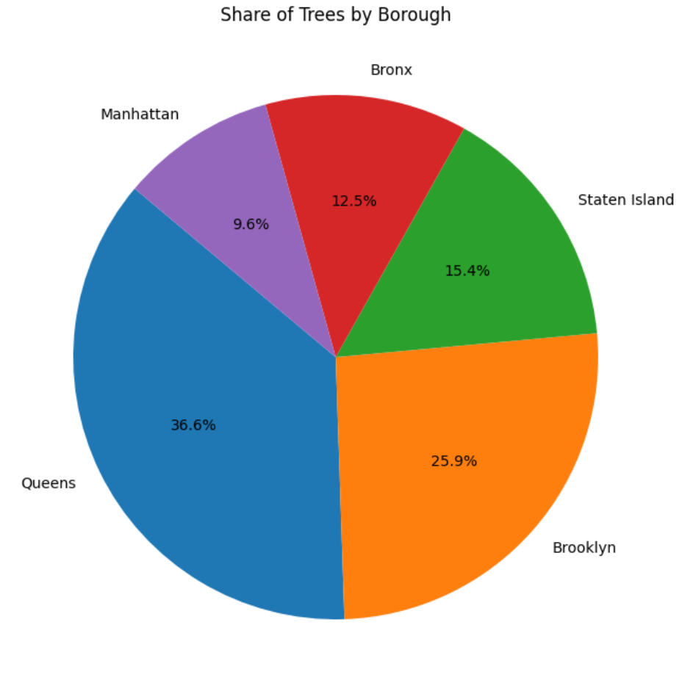
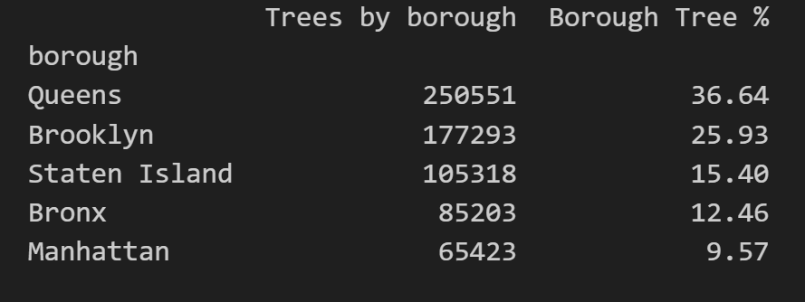
Findings and conclusions
Tree Distribution by Borough (Total and Percentage)
The analysis shows that there are a total of 683,788 trees in the New York City boroughs. The largest number of trees is in Queens, followed by Brooklyn, Staten Island, the Bronx, and Manhattan.

Slide 6
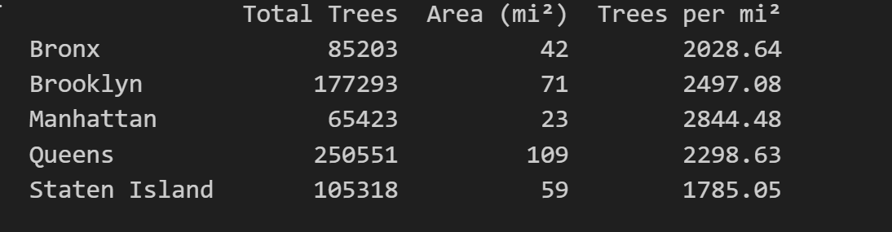
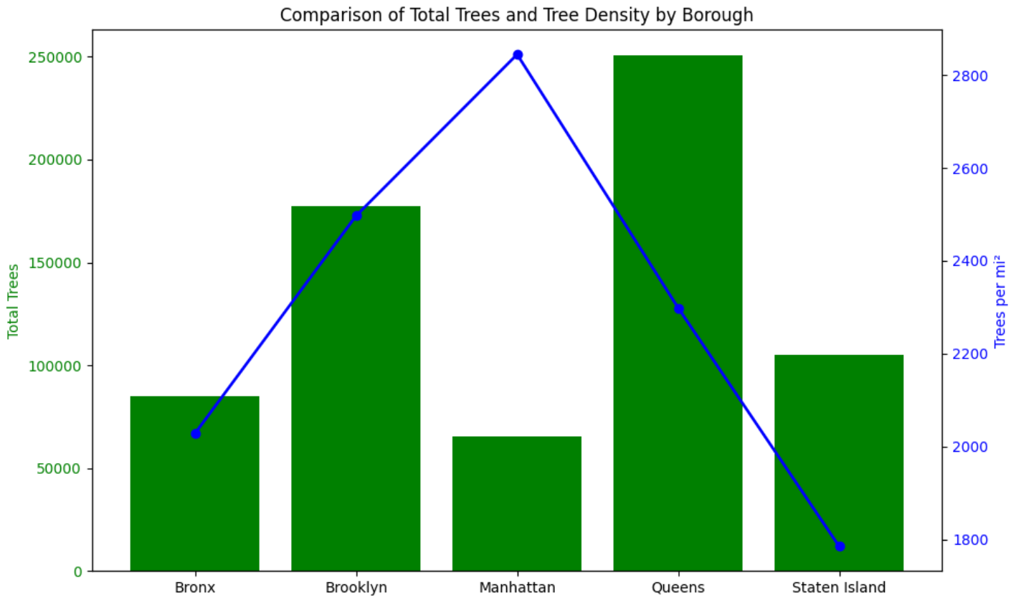
Findings and conclusions
Tree density per square mile by borough
Although Manhattan has the fewest trees overall, an analysis of tree density per square mile by borough shows that Manhattan has the most trees per square mile, followed by Brooklyn, Queens, the Bronx, and Staten Island.

Slide 7
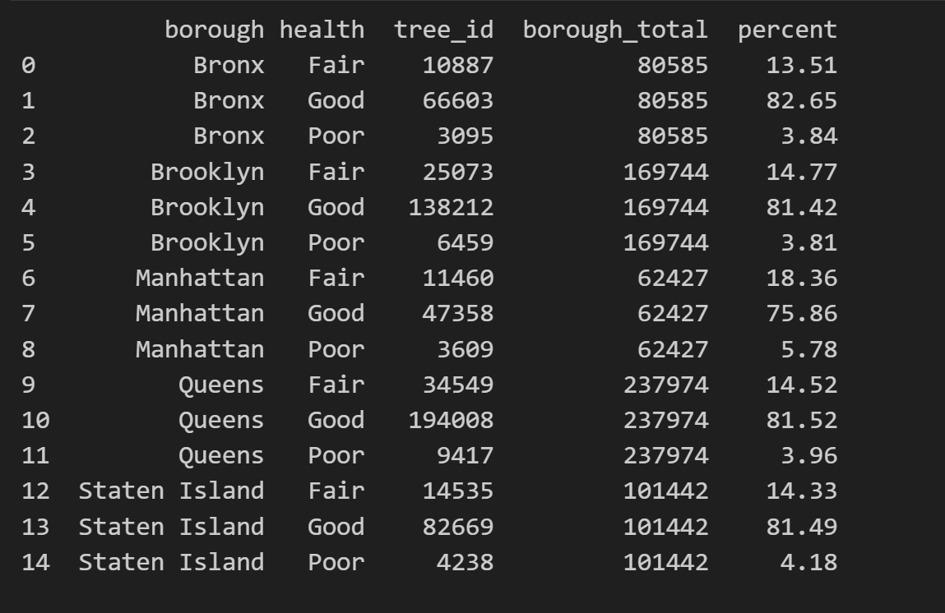
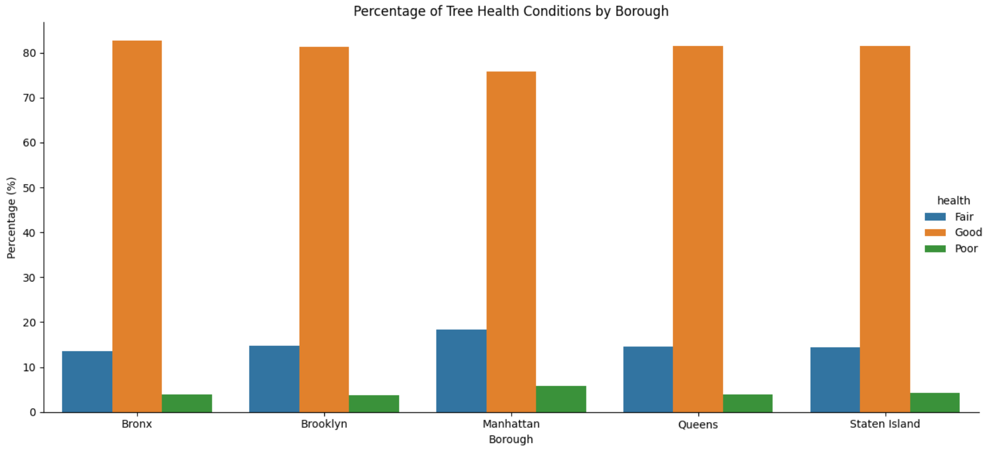
Findings and conclusions
Tree Health Condition Breakdown (Good, Fair, Poor) by Borough, Total and Percentage
It should be noted that tree health is generally consistent across all boroughs
However, Manhattan is slightly behind the other bureaus in terms of tree health

Slide 8
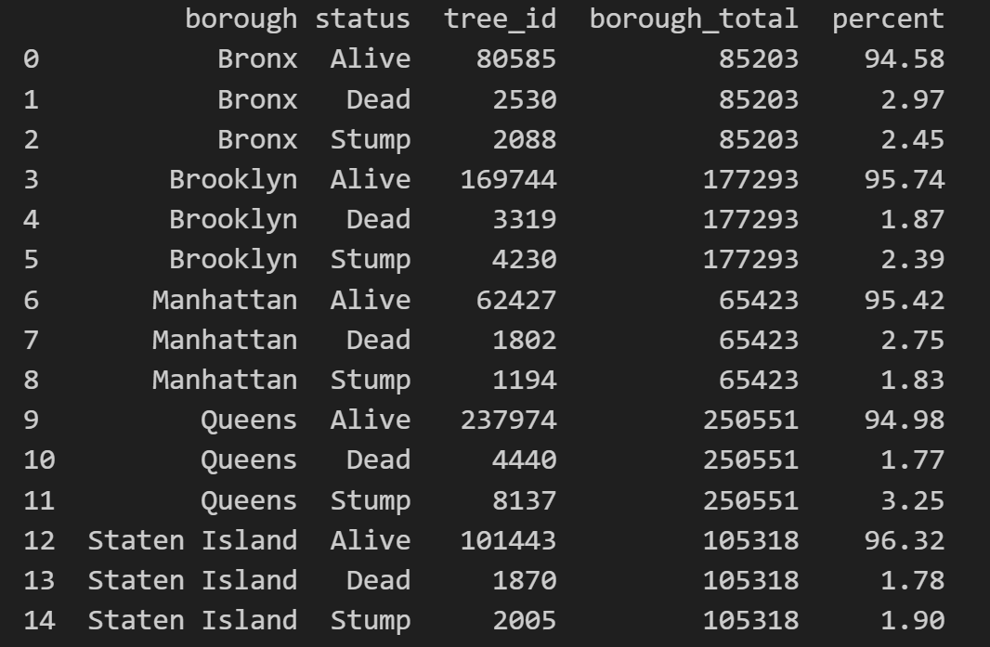
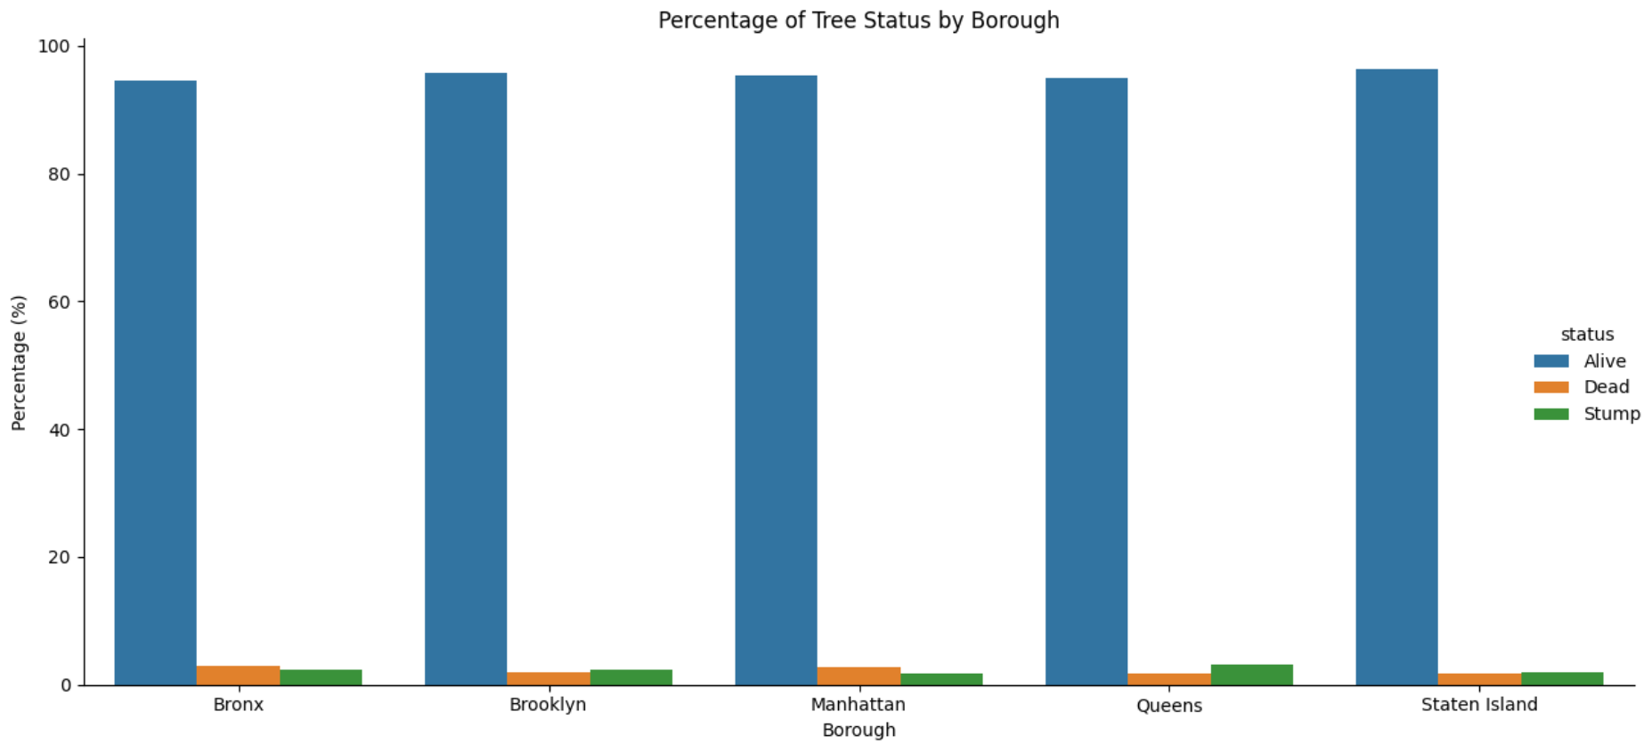
Findings and conclusions
Tree status Breakdown (Alive, Dead, Stump) by Borough, Total and Percentage
Most trees across all boroughs are alive and in good health

Slide 9
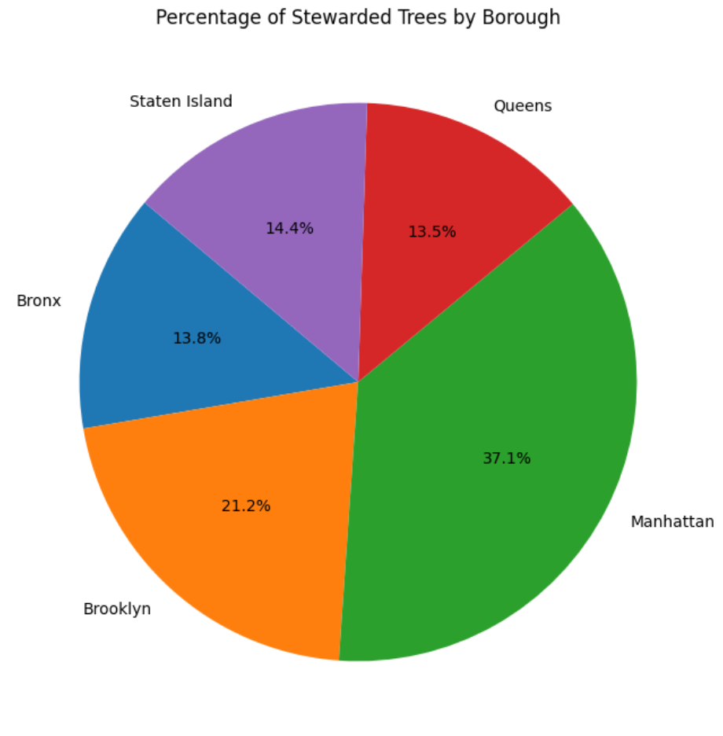
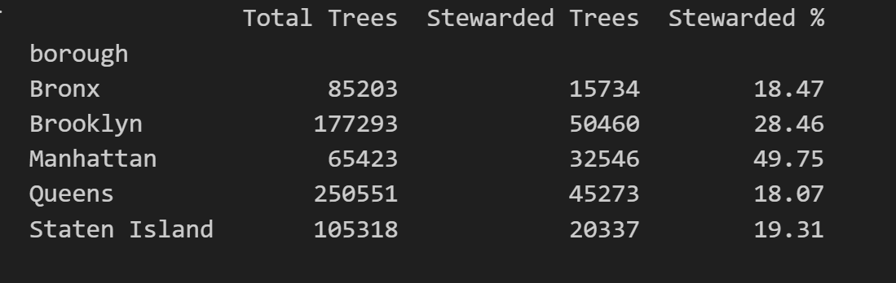
Findings and conclusions
Stewarded trees by borough, Total and Percentage
For this analysis, I modified the existing data. The original data type for the existing column was text, so I converted it into integer to calculate both the number and percentage of stewarded trees by borough. The conversions were as follows: "None" was changed to 0; "1or2" became 1; "3or4" was assigned a value of 3; and "4orMore" was changed to 4.
As we can see, the most stewarded trees are in the Manhattan area

Slide 10
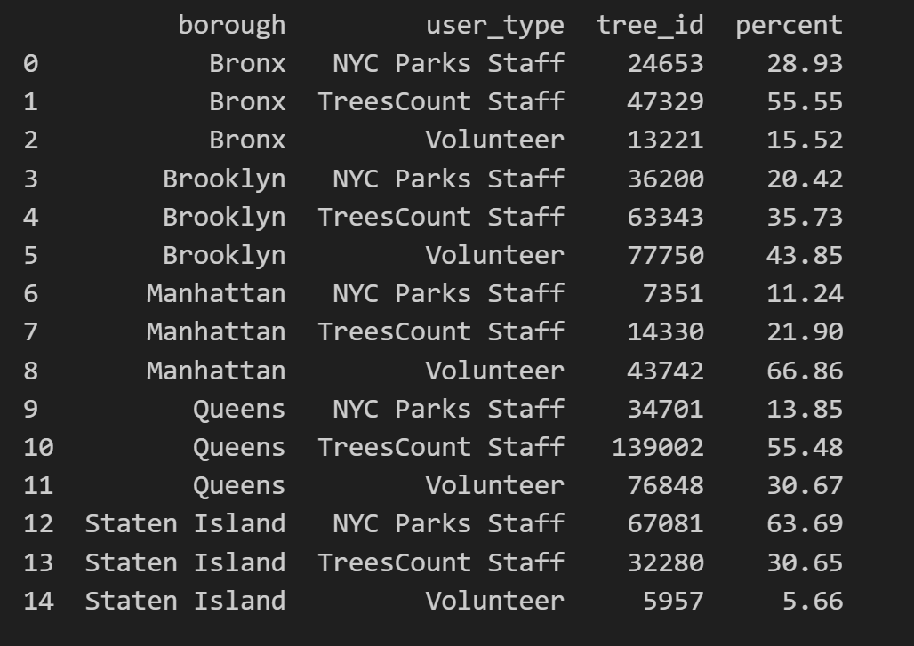
Findings and conclusions
Tree data collected by each user type within each borough, Total and Percentage
As we can see, tree inventory data was collected not only by municipal organizations, such as NYC Parks Staff and TreesCount Staff, but also by a group of volunteers. The highest volunteer participation was in Manhattan (66.86%) and Brooklyn (43.85%)."

Slide 11
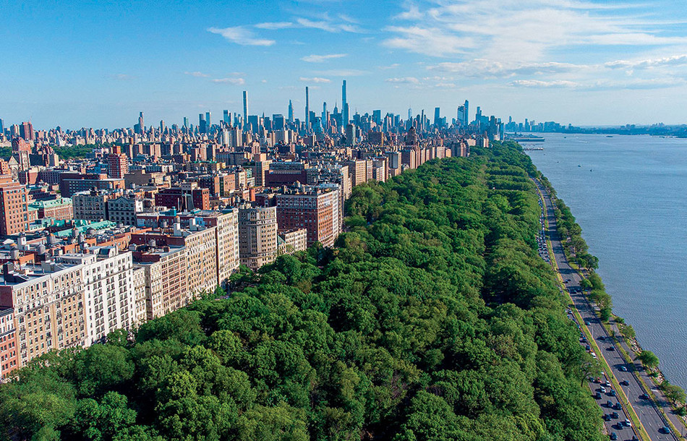
Findings and conclusions
To sum up, the overall number of trees (over half a million) and their health condition across all NYC boroughs are quite impressive. It seems that both the municipality and local residents are actively involved in identifying issues (some were flagged during the survey) and in keeping the city green.
At the start of this analysis, I didn’t expect the trees to be in such remarkably good health—and the large number of trees is impressive as well
https://magazine.columbia.edu/article/incredible-environmental-benefits-nyc-trees

Slide 12
References:
https://data.cityofnewyork.us/Environment/2015-Street-Tree-Census-Tree-Data/uvpi-gqnh/about_data
https://www.nymtc.org/portals/0/pdf/CPT-HSP/NYMTC%20coord%20plan%20NYC%20CH03.pdf
Pictures:
https://www.cnu.org/publicsquare/2018/12/14/benefits-urban-trees
https://www160.statcan.gc.ca/index-eng.htm
https://magazine.columbia.edu/article/incredible-environmental-benefits-nyc-trees
https://medium.com/@deepaksharma2494/20-pandas-functions-to-complete-80-of-your-data-science-tasks-cefa535a629e

